Slide 1
Car Price Prediction

Slide 2

Project Aim :-
To predict the sales price for each car.

Slide 3
TEAM MEMBERS
2210992552
2210992549
2210990092
2210992432

Slide 4
CONTENT
Problem Statement
Objective
Tools Used
Data Summary
Exploratory Data Analysis
Challenges
Recommendations
Conclusions

Slide 5
PROBLEM STATEMENT
The primary challenge addressed by this project is to develop a predictive model that can accurately estimate the market value of a car based on its features and specifications. This involves understanding and quantifying the relationship between a car's sale price and its attributes using historical data. The model must be capable of handling a wide variety of cars, from economical to luxury models, and account for the non-linear and complex interactions between features that influence a car's price.

Slide 6
OBJECTIVE
The objective of the Car Price Prediction project is to develop a predictive model that accurately estimates the sales price of cars. By analyzing various features such as mileage, brand, and condition, the model aims to assist buyers and sellers in making informed decisions.
Through data analysis and machine learning techniques, the project aims to provide reliable estimates of car prices, aiding buyers in budgeting and sellers in setting competitive prices. Ultimately, it seeks to enhance transparency and efficiency in the automotive market.

Slide 7
Tools used
GOOGLE COLLAB is used as IDE.
Pandas and NumPy are used for Data Manipulation & Pre-processing and Mathematical functions respectively.
Exploratory data analysis is automated by data prep
For visualization of the plots, Matplotlib, Seaborn, Plotty are used.
GitHub is used as version control system

Slide 8
DATA SUMMARY
NUMERICAL DATA
symbolling , wheelbase, carlength, carwidth ,carheight , curbweight , enginesize , boreratio, stroke, compressionratio , horsepower, peakrpm , citympg , highwaympg , price
CATEGORIAL DATA
car_ID , CarName ,fueltype , aspiration ,doornumber, carbody , drivewheel , enginelocation ,enginetype ,cylindernumber ,fuelsystem

Slide 9
•UNIQUE DATA
1. car_ID (unique identifier for each car model)
2. CarName (name of the car model)
3. fueltype (type of fuel used by the car: gas or diesel)
4. aspiration (type of aspiration system in the car's engine: std or turbo)
5. doornumber (number of doors in the car: two or four)
6. carbody (body style of the car: sedan, hatchback, convertible, etc.)
7. drivewheel (type of drivetrain: front-wheel drive, rear-wheel drive, four-wheel drive)
8. enginelocation (location of the engine in the car: front or rear)
9. enginetype (type of engine.)
10. cylindernumber (number of cylinders in the engine)
11. fuelsystem (type of fuel injection system used in the engine)

Slide 10
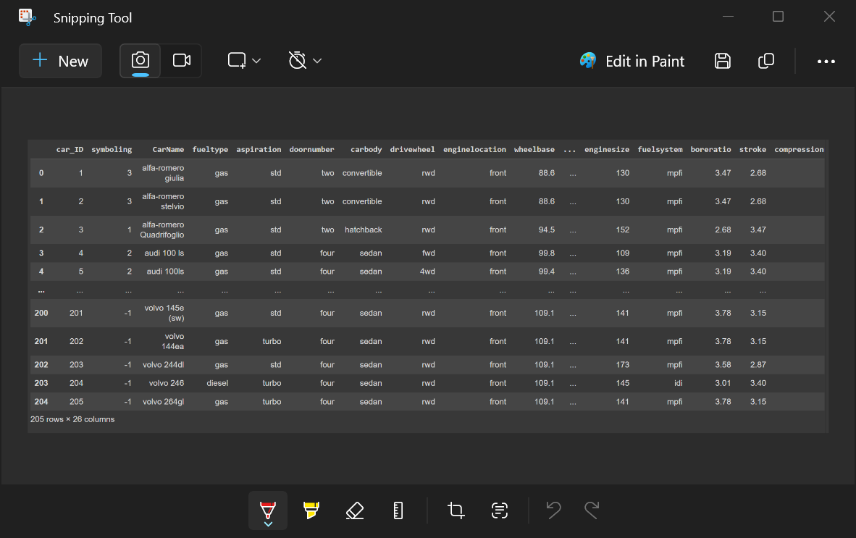
DATA SUMMARY

Slide 11
FEATURE DESCRIPTION
car_ID: A unique identifier for each car model.
symboling: The insurance risk rating associated with the car, represented as an integer.
CarName: The name of the car model.
fueltype: The type of fuel used by the car (e.g., gas or diesel).
aspiration: The type of aspiration system in the car's engine (e.g., std or turbo).
doornumber: The number of doors in the car (e.g., two or four).
carbody: The body style of the car (e.g., sedan, hatchback, convertible).
drivewheel: The type of drivetrain (e.g., front-wheel drive, rear-wheel drive, four-wheel drive).
enginelocation: The location of the engine in the car (e.g., front or rear).
wheelbase: The distance between the centers of the front and rear wheels.
carlength: The length of the car.
carwidth: The width of the car.
carheight: The height of the car.
curbweight: The weight of the car without occupants or baggage.

Slide 12
FEATURE DESCRIPTION
enginetype: The type of engine (e.g., dohc, ohcv).
cylindernumber: The number of cylinders in the engine.
enginesize: The size of the engine in cubic centimeters.
fuelsystem: The type of fuel injection system used in the engine.
boreratio: The bore ratio of the engine.
stroke: The stroke length of the engine.
compressionratio: The compression ratio of the engine.
horsepower: The horsepower of the engine.
peakrpm: The peak revolutions per minute of the engine.
citympg: The city miles per gallon fuel efficiency rating.
highwaympg: The highway miles per gallon fuel efficiency rating.
price: The price of the car.

Slide 13
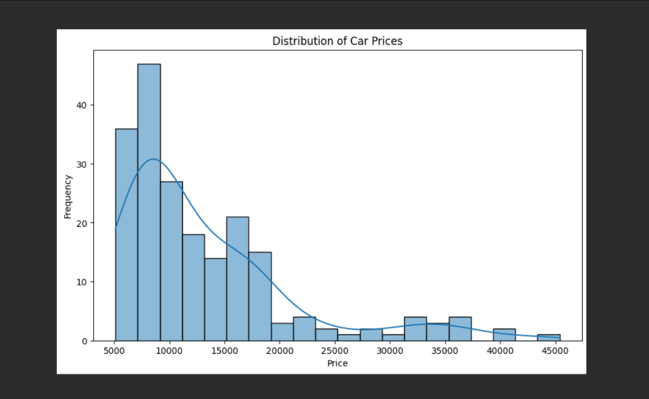
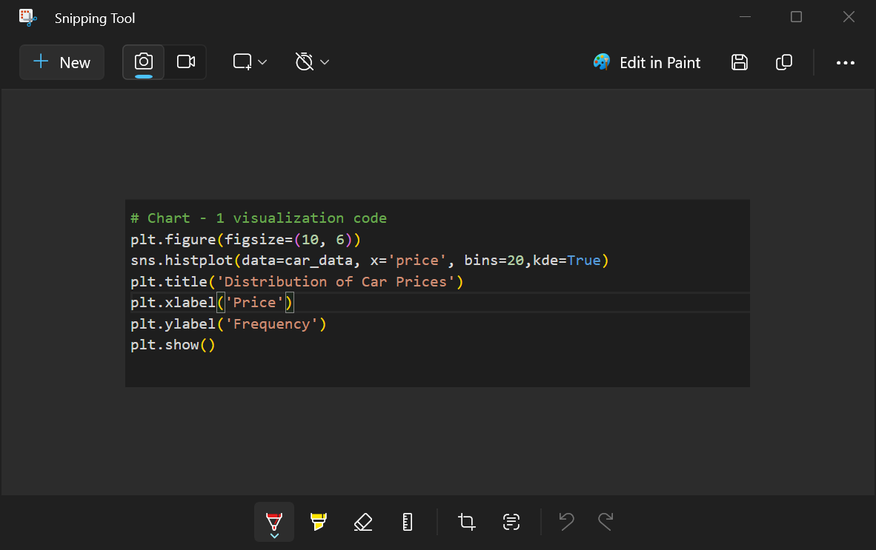
Distribution of Car Prices

Slide 14
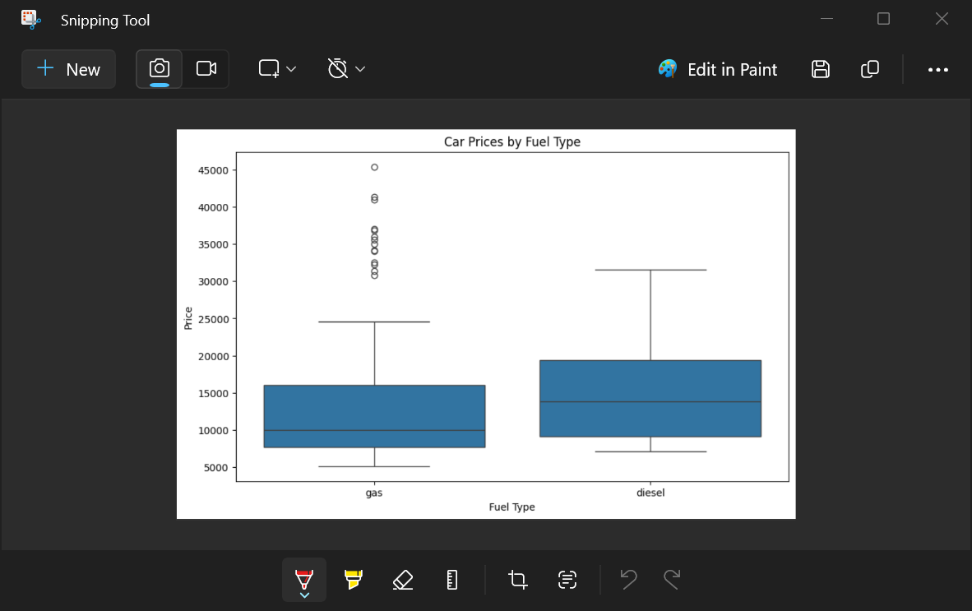
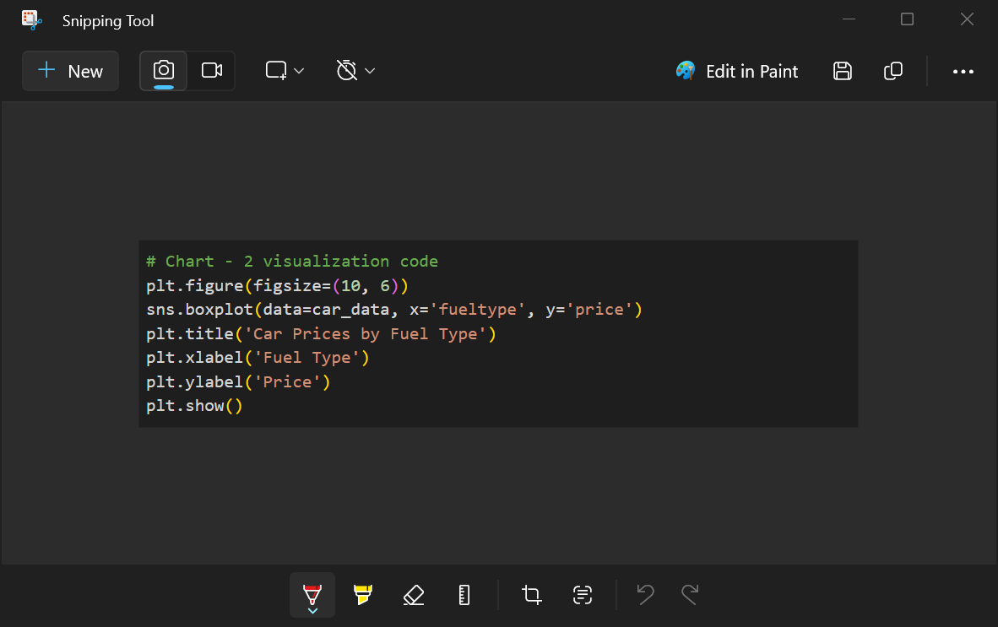
Car Prices by Fuel Type

Slide 15
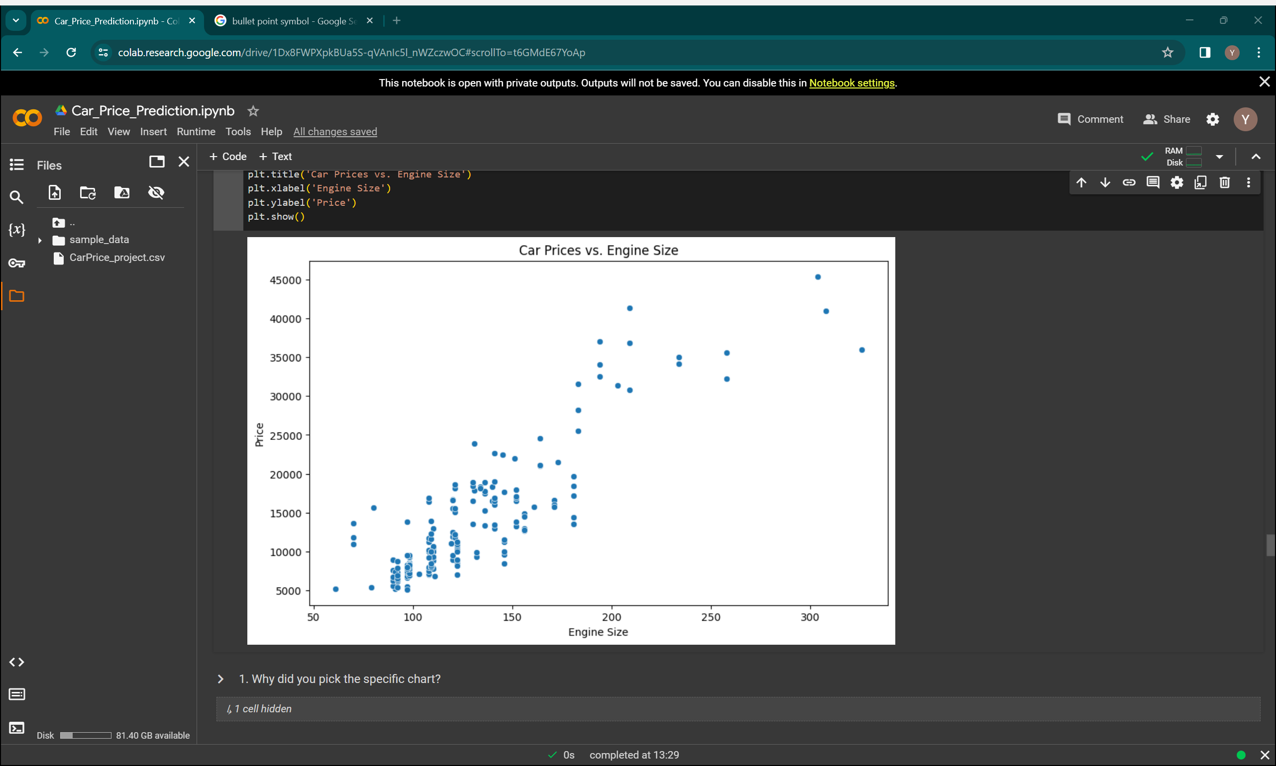
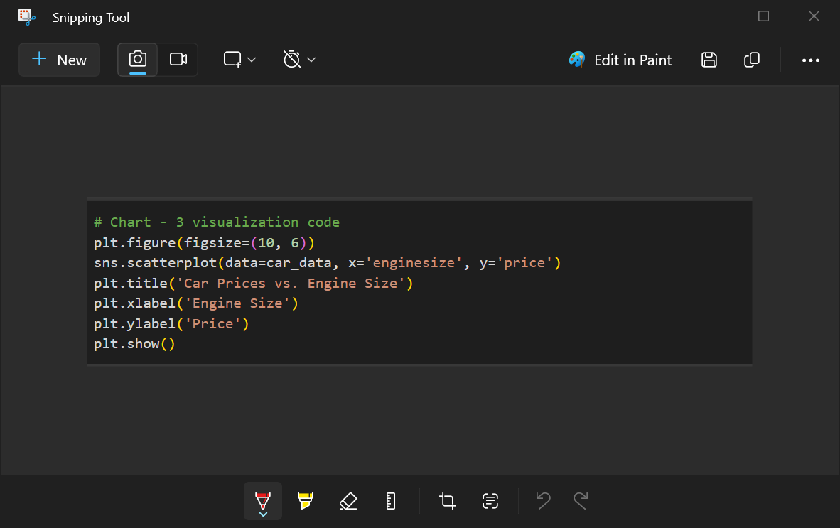
Car Prices vs. Engine Size

Slide 16
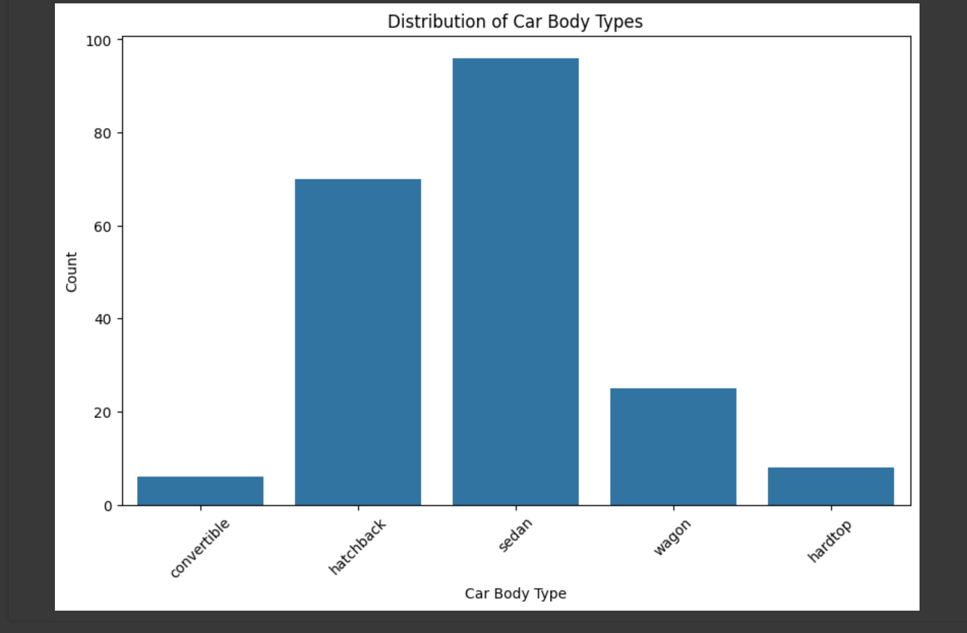
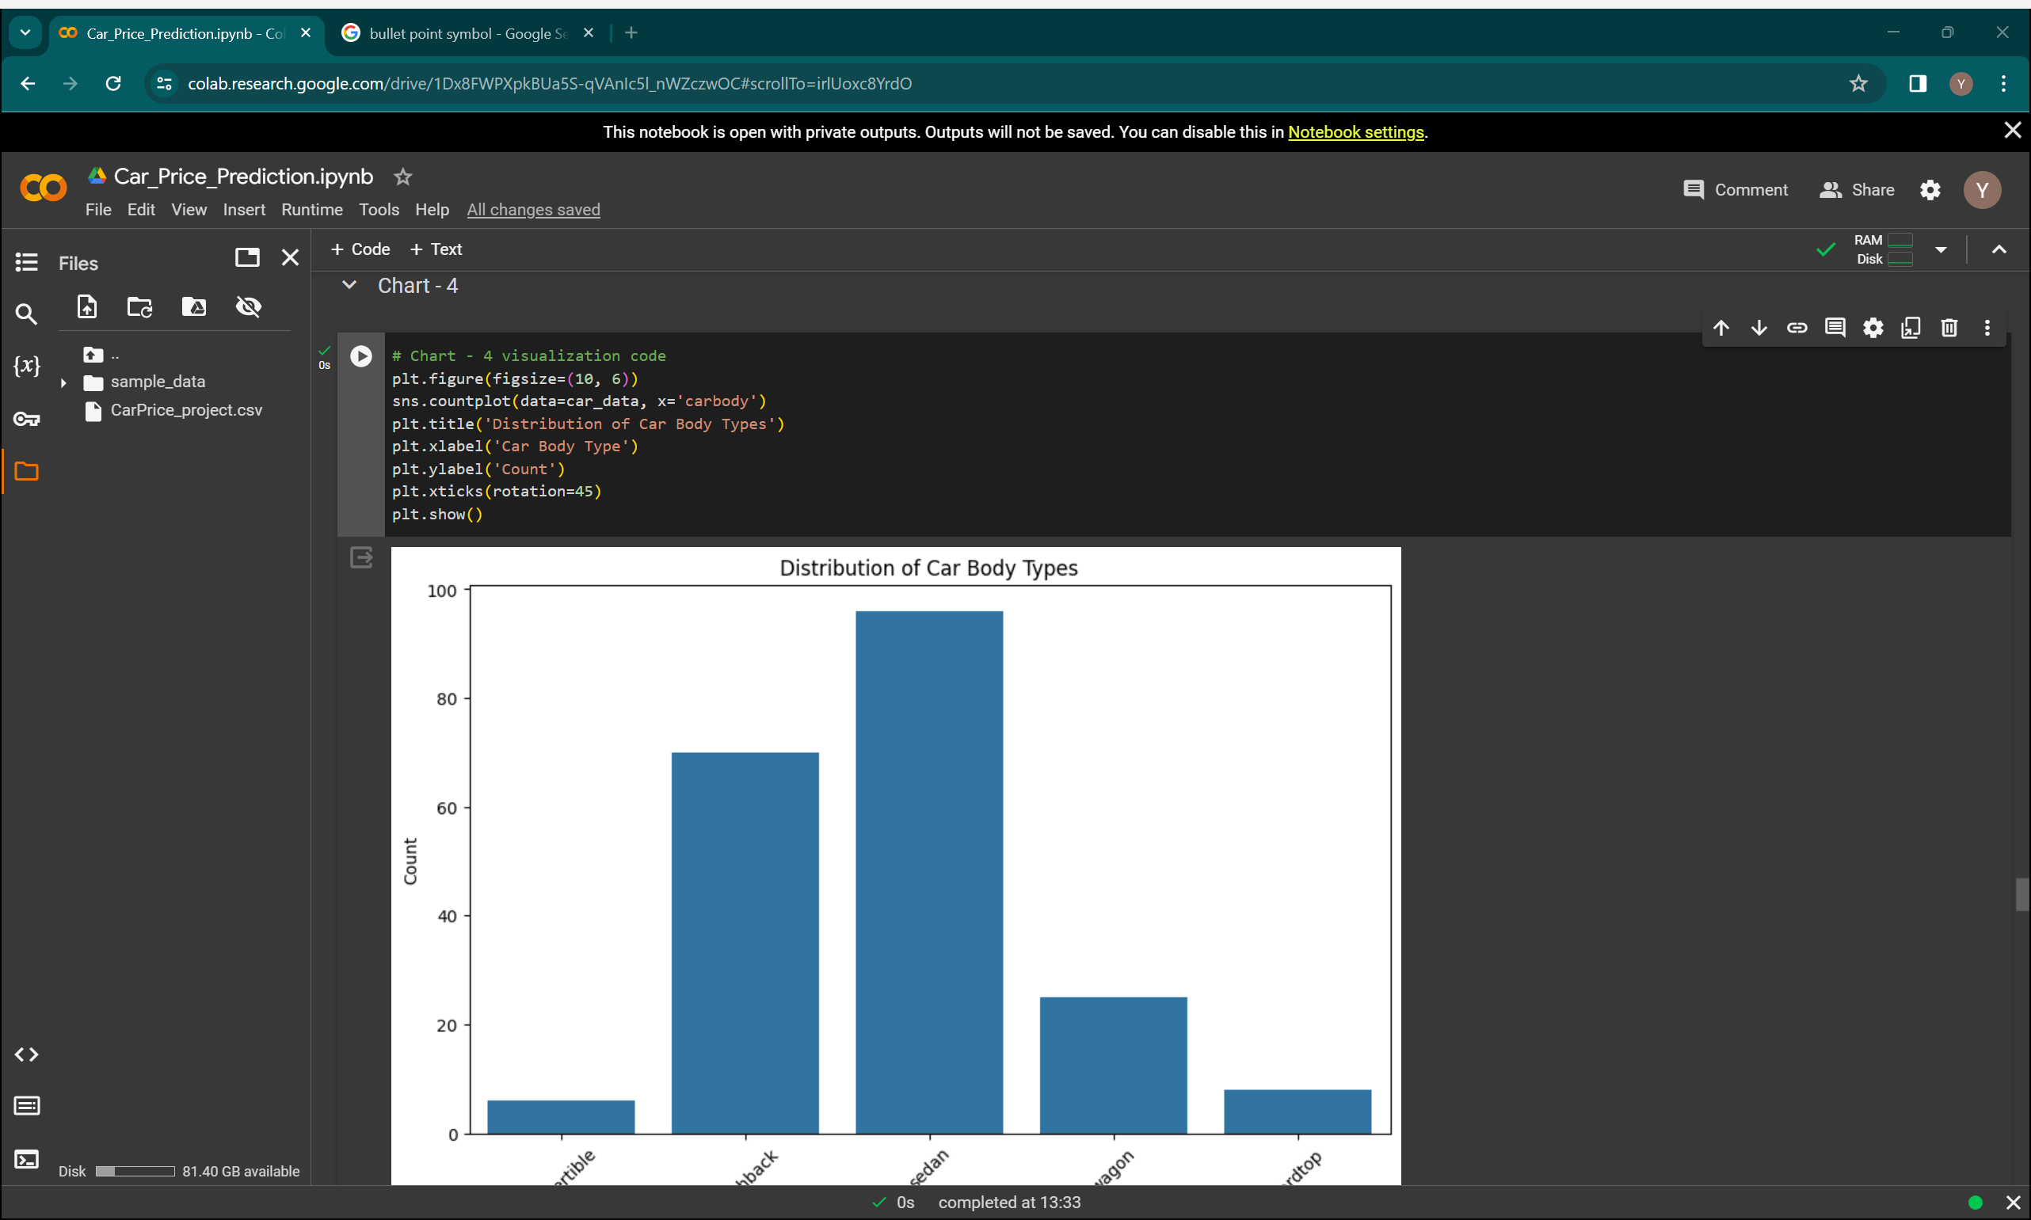
Distribution of Car Body Types

Slide 17
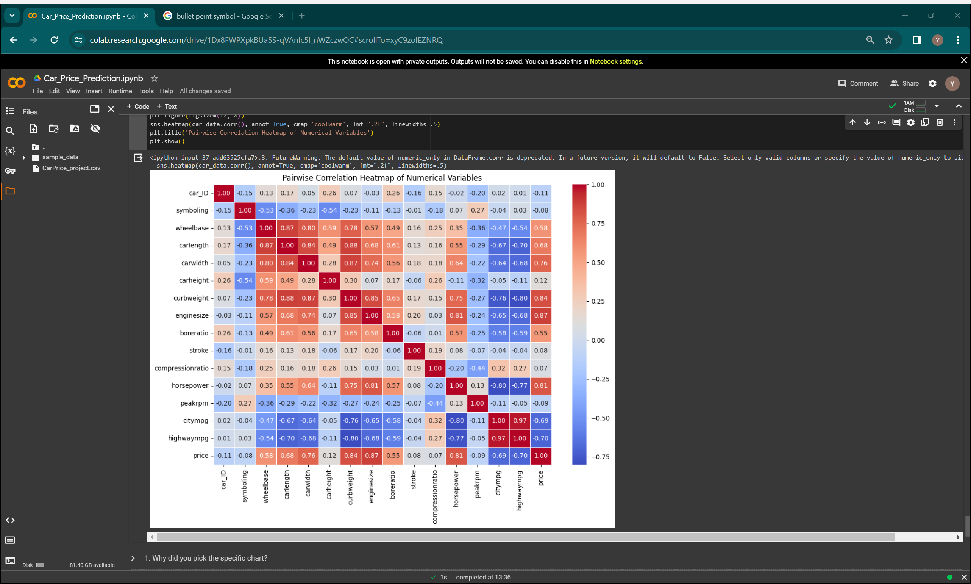
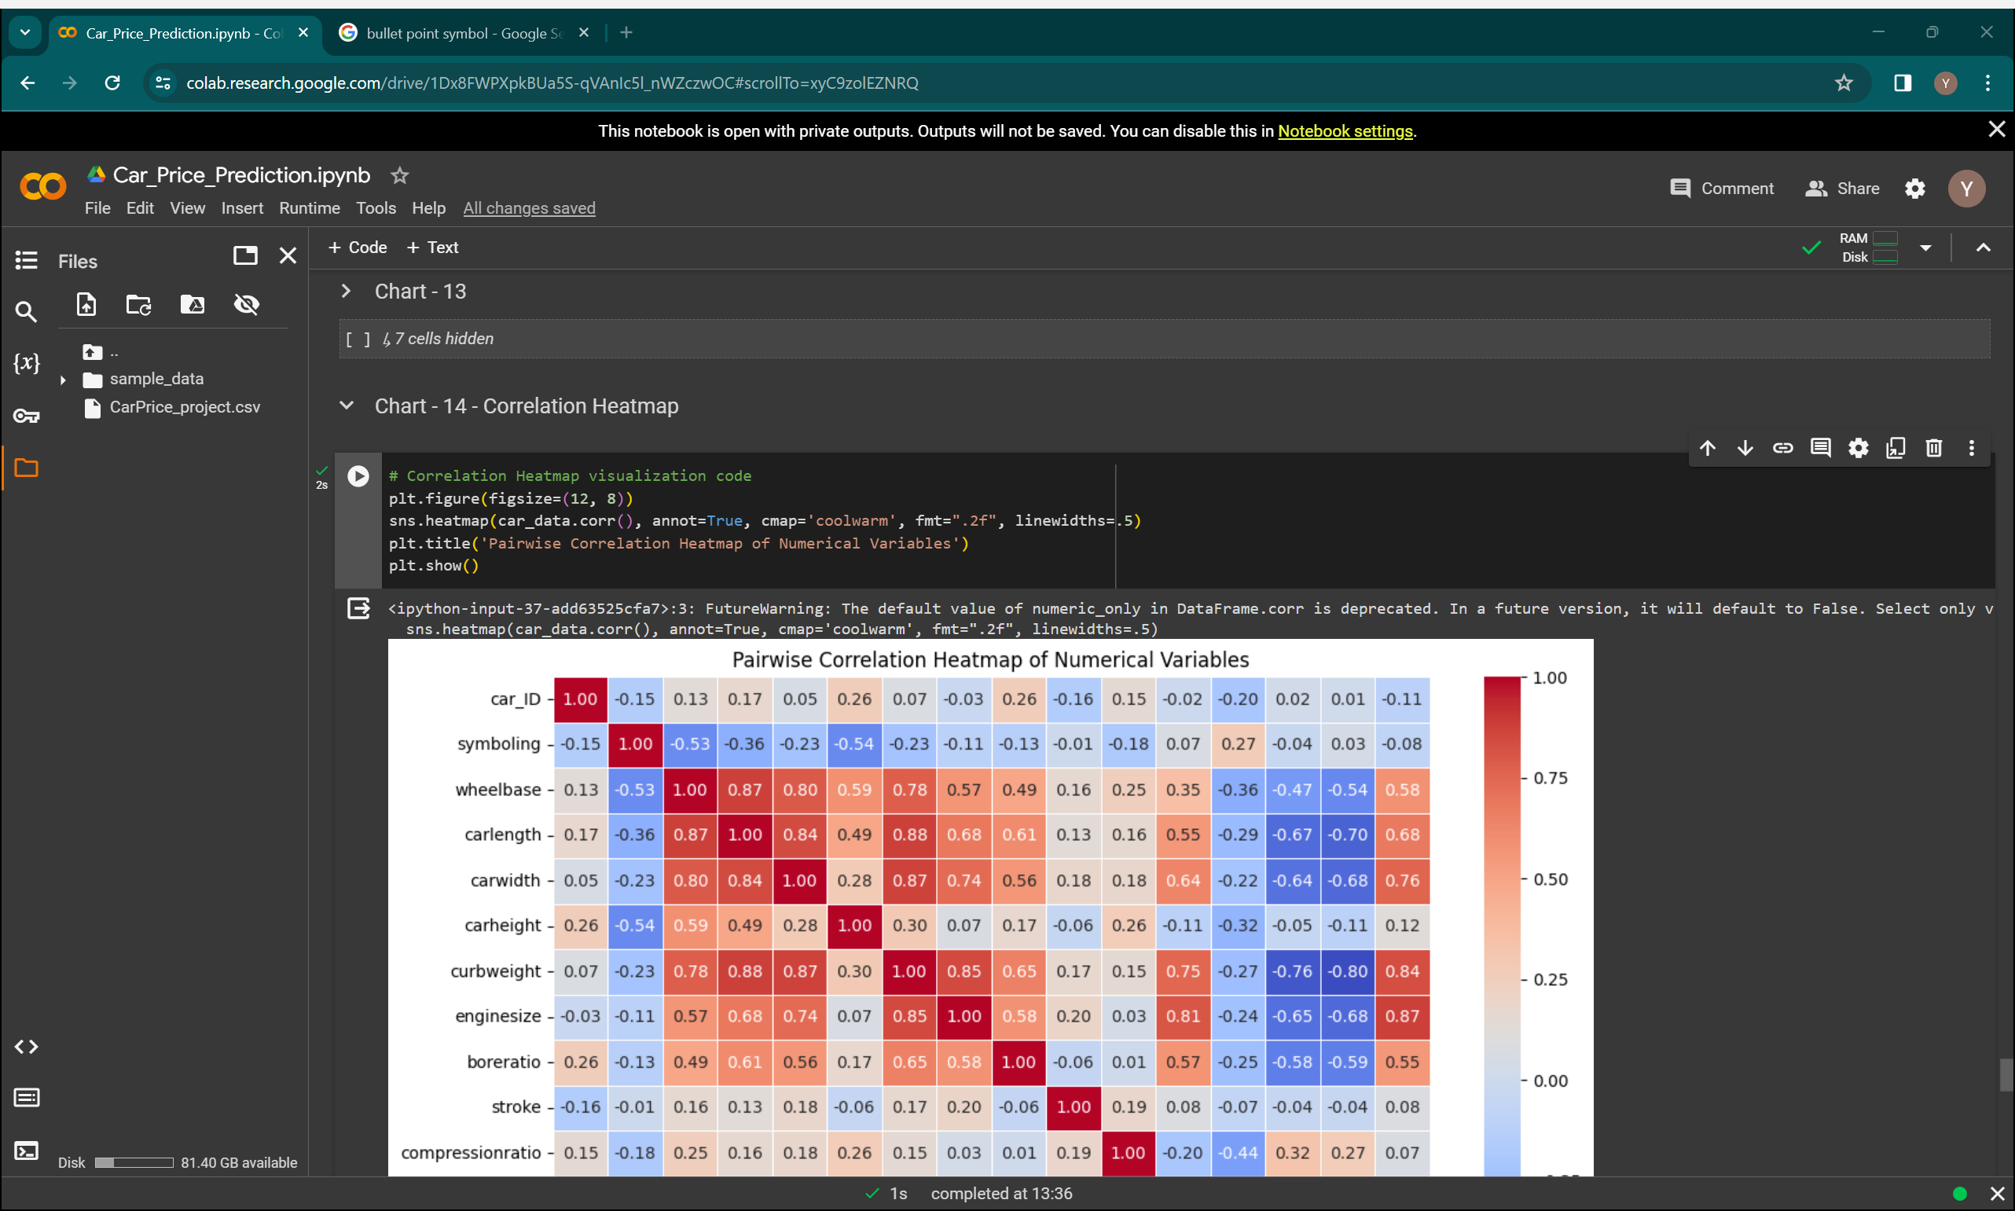
Pairwise Correlation Heatmap of Numerical Variables

Slide 18
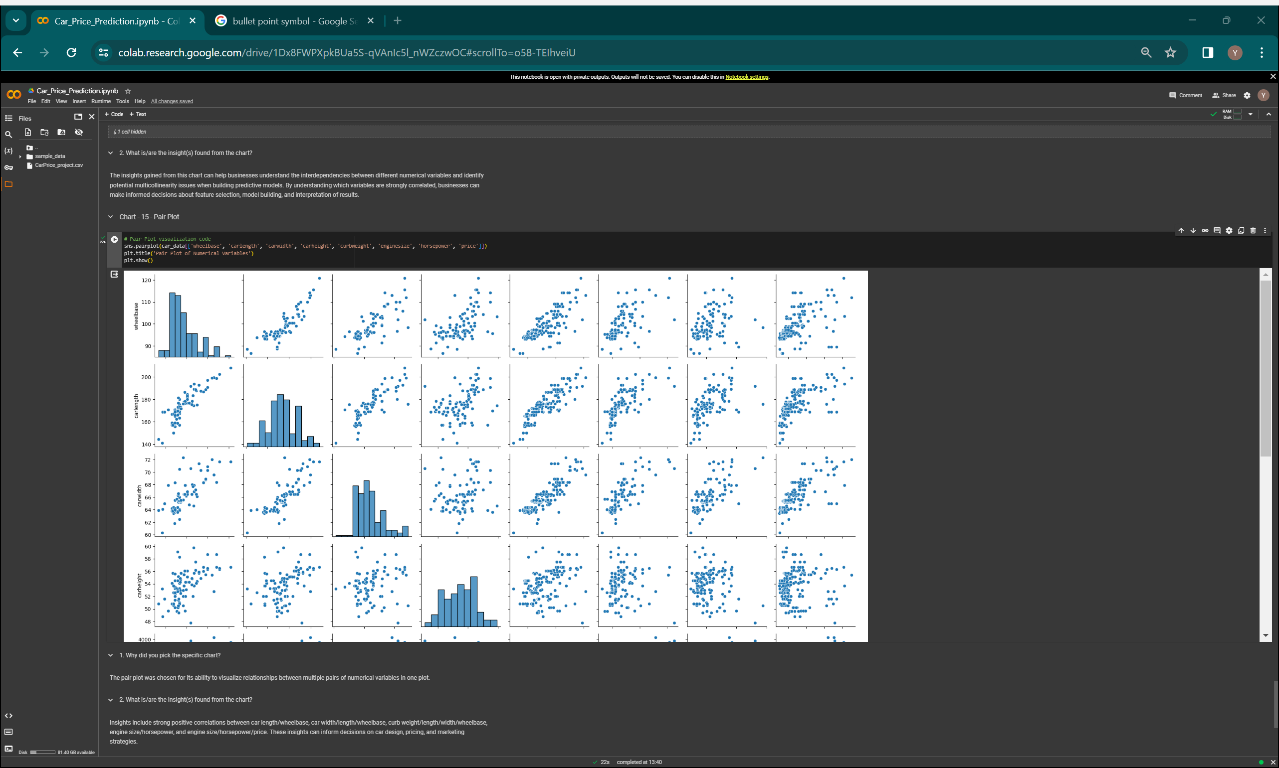
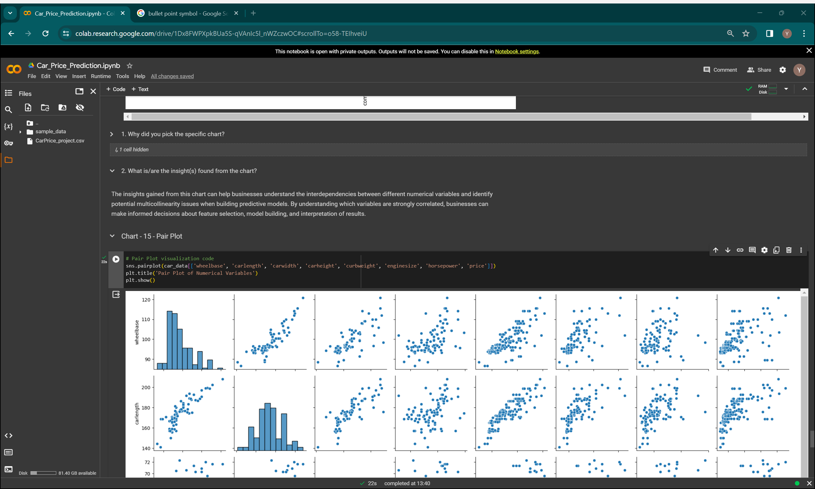
Pair Plot of Numerical Variables

Slide 19
CHALLENGES
Data inconsistencies: Ensuring uniformity and accuracy across different data sources and formats.
Missing values: Handling null or incomplete data points effectively without biasing analysis.
Outlier detection: Identifying and addressing anomalies that can skew analysis and model performance.
Feature engineering: Selecting and creating relevant features for predictive modeling and analysis.
Handling categorical variables: Encoding categorical data into numerical form for machine learning algorithms.

Slide 20
Recommendations
Fill in Missing Information
Spot and Handle Weird Numbers
Make Categories Clear
Choose the Right Model
Double-Check Results
Keep Data Safe
Write Down Your Process
Stay Organized

Slide 21
LiBRARIES IMPORTED
pandas: Used for data manipulation and analysis
train_test_split: From sklearn.model_selection, used to split the dataset into training and testing sets.RSF
LabelEncoder: From sklearn.preprocessing, used to encode categorical variables into numerical format.
LinearRegression, DecisionTreeRegressor, RandomForestRegressor: From sklearn.linear_model and sklearn.ensemble, used for regression modeling.
mean_absolute_error, mean_squared_error, r2_score: From sklearn.metrics, used to evaluate model performance.

Slide 22
Model Imported
from sklearn.linear_model import LinearRegression: This imports the LinearRegression class for creating a linear regression model. This model assumes a linear relationship between the features (like mileage, year) and the target variable (price).
from sklearn.tree import DecisionTreeRegressor: This imports the DecisionTreeRegressor class for creating a decision tree regression model. This model splits the data based on feature values to predict a continuous target variable like car price.
from sklearn.ensemble import RandomForestRegressor: This imports the RandomForestRegressor class for creating a random forest regression model. This model combines multiple decision trees, leading to potentially better performance and reduced overfitting compared to a single decision tree.

Slide 23
Metrices imported
Evaluation Metrics Import: from sklearn.metrics import mean_absolute_error, mean_squared_error, r2_score: This line imports three functions from the sklearn.metrics library for evaluating the performance of the models:
mean_absolute_error (MAE): This function calculates the average difference between the predicted prices and the actual prices.
mean_squared_error (MSE): This function calculates the average squared difference between the predicted prices and the actual prices. Squaring the errors gives more weight to larger errors.
r2_score (R-squared): This function calculates the R-squared score, which represents the proportion of variance in the target variable (price) explained by the model. A higher R-squared value indicates a better fit.

Slide 24
Data loading and processing
data = pd.read_csv('/content/CarPrice_project.csv'): This line reads the car price data from a CSV file located at the specified path (/content/CarPrice_project.csv) using the pandas library (pd). The data is loaded into a pandas DataFrame (data).
data.dropna(inplace=True): This line handles missing values in the data. The .dropna(inplace=True) function removes rows with missing values from the DataFrame (data) and modifies the DataFrame itself.

Slide 25
Categorical variable encoding
label_encoder = LabelEncoder(): This line creates a LabelEncoder object.
categorical_cols = [...]: This line defines a list named categorical_cols that contains the names of the columns with categorical data (e.g., car names, fuel types).
for col in categorical_cols: ...: This loop iterates through each column name in the categorical_cols list.
data[col] = label_encoder.fit_transform(data[col]): This line encodes the categorical values in the specified column (col) using the LabelEncoder object. The .fit_transform method first learns the unique categories in the column and then assigns a numerical label to each category.

Slide 26
Data splitting
X = data.drop(columns=['car_ID', 'price']): This line creates a new DataFrame named X that contains all columns except "car_ID" and "price". The "car_ID" column is likely an identifier and not relevant for price prediction, and the "price" column is the target variable we want to predict.
y = data['price']: This line creates a new pandas Series named y that contains only the "price" column (the target variable).
X_train, X_test, y_train, y_test = train_test_split(X, y, test_size=0.2, random_state=42): This line splits the data into training and testing sets using the train_test_split function from scikit-learn.
X: The features DataFrame.
y: The target variable Series (price).
test_size=0.2: This parameter specifies that 20% of the data will be used for the testing set.

Slide 27
CONCLUSIONS
Price Variation: There is significant variation in car prices across different makes and models, likely influenced by factors such as brand reputation, features, and market demand.
Fuel Efficiency Trends: Higher-priced cars tend to have lower highway mpg, suggesting that luxury or performance features may come at the expense of fuel efficiency.
Body Style Preferences: Certain body styles, such as sedans and hatchbacks, appear more frequently in the dataset compared to others, indicating potential consumer preferences or market trends.
Brand Influence: Brands like Audi and BMW feature prominently in the dataset, suggesting their popularity or market presence in the automotive industry.
Drive Wheel Distribution: Rear-wheel drive (rwd) seems to be more common among luxury or performance-oriented vehicles, while front-wheel drive (fwd) is prevalent across a wider range of car types, reflecting different design priorities and target markets.

Slide 28
THANK YOU !!

